Slide 1
Envision® by the Numbers
Release date: April 18, 2023
Q1-2023

Slide 2
Purpose
To equip Envision Sustainability Professionals (ENV SPs) and other champions for sustainable infrastructure with Envision stats and graphs, which may be used to support presentations on Envision, business cases, etc.
Please credit ISI.
This PowerPoint presentation shall be updated quarterly each year in January, April, July, and October.
Questions? Please direct them to info@sustainableinfrastructure.org

Slide 3
What’s inside
Envision by the numbers: project verification and awards
Envision by the numbers: education and credentialing
Envision by the numbers: members and suppliers
Founders and global partners
List of marketing resources

Slide 4
1
Envision by the numbers: project verification and awards

Slide 5
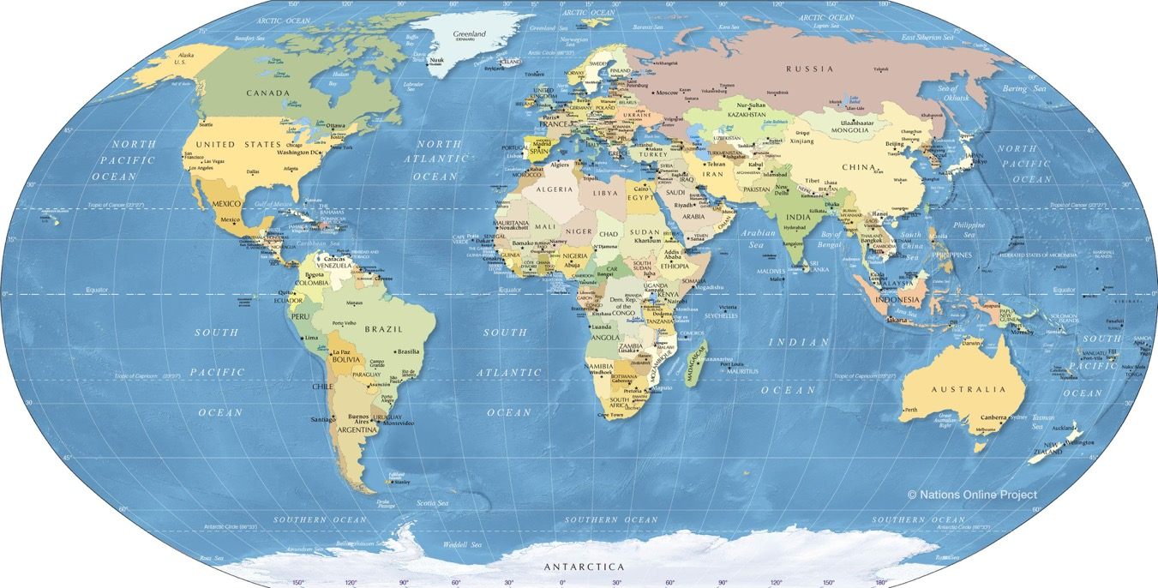
Envision projects in the verification program
All projects (registered, under review, & complete)
Geographic scale: international
31
255
1
14
1
11
1
Total = 314
As of March 31, 2023

Slide 6
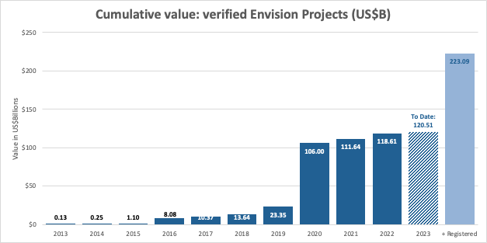
Cumulative value
All projects (registered, under review, & complete)
Geographic scale: International
USD$223.1B
Total = 314
As of March 31, 2023

Slide 7
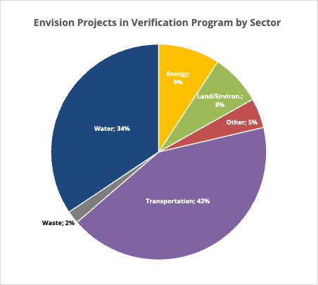
Envision projects in the verification program, by sector
All projects (registered, under review, & complete)
Geographic scale: international
Total = 314
As of March 31, 2023

Slide 8
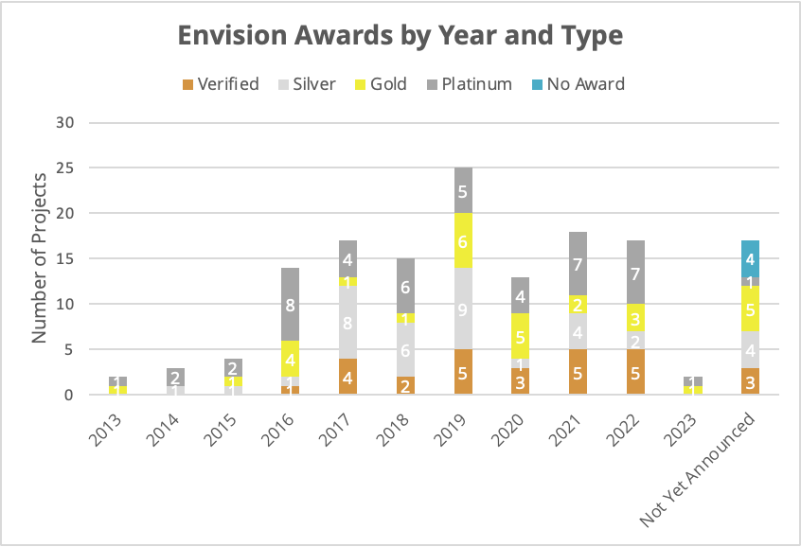
Envision awards, by year and type
Geographic scale: international
To Date
Total = 147
As of March 31, 2023

Slide 9
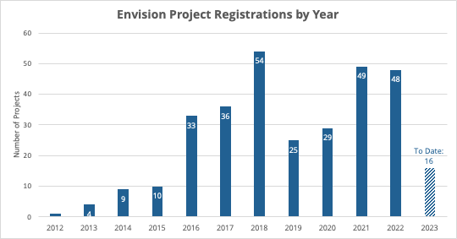
Envision project registrations by year
Geographic scale: international
Total = 314
As of March 31, 2023

Slide 10
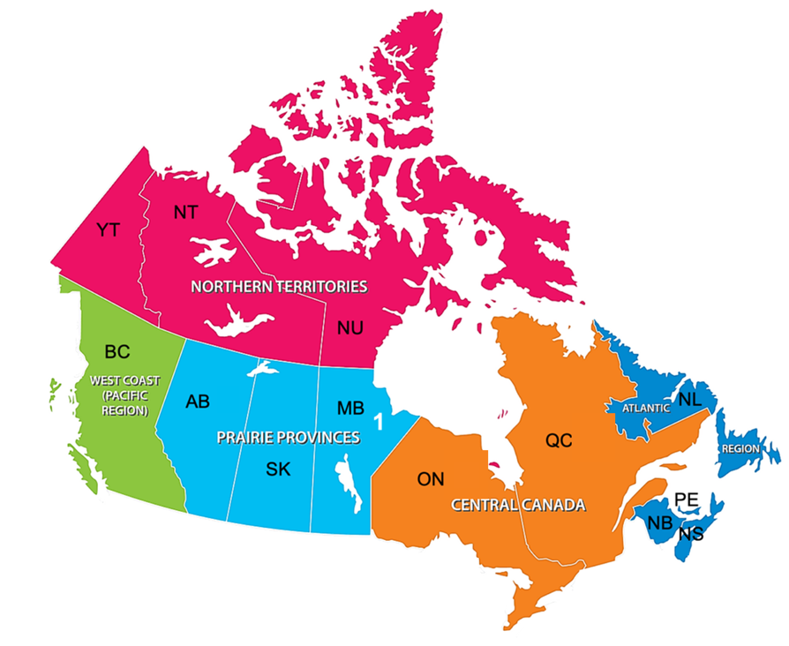
Envision projects in the verification program
All projects (registered, under review, & complete)
Geographic scale: Canada
0
11
10
11
3
10
5
Total = 31
4
1
1
15
As of March 31, 2023

Slide 11
Cumulative value
All projects (registered, under review, & complete)
Geographic scale: Canada
CAD$16.6B
As of March 31, 2023

Slide 12
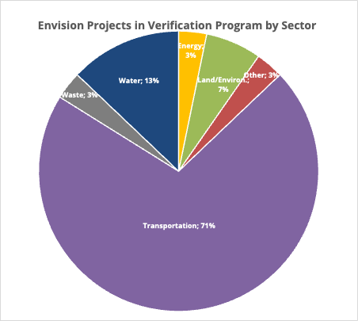
Envision projects in the verification program, by sector
All projects (registered, under review, & complete)
Geographic scale: Canada
Total = 31
As of March 31, 2023

Slide 13
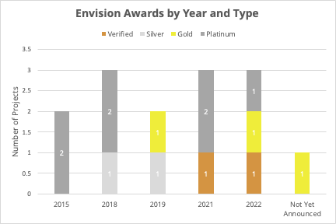
Envision awards, by year and type
Geographic scale: Canada
Total = 14
As of March 31, 2023

Slide 14
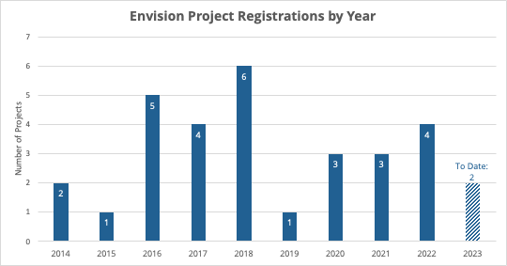
Envision project registrations by year
Geographic scale: Canada
Total = 31
As of March 31, 2023

Slide 15
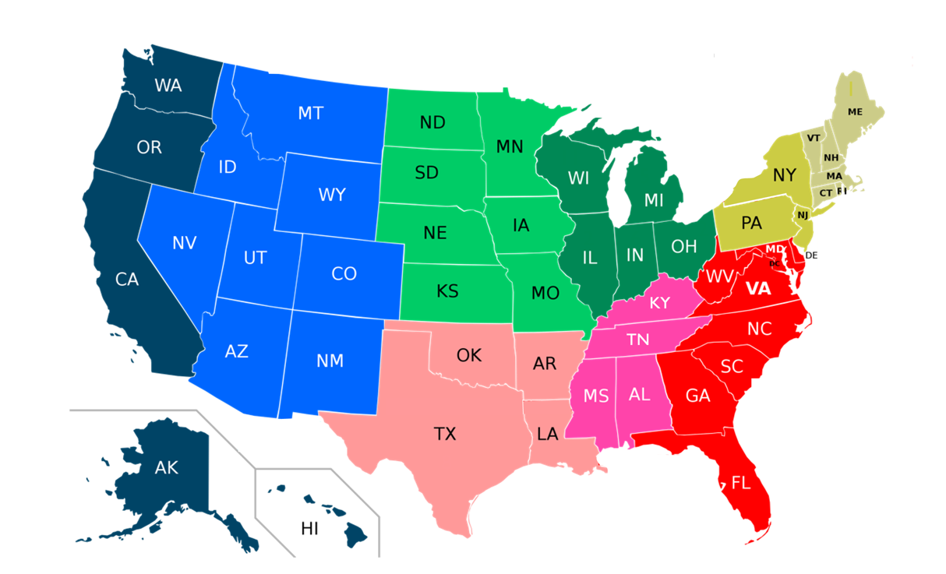
Envision projects in the verification program
All projects (registered, under review, & complete)
Geographic scale: United States
9
15
10
1
26
4
1
11
41
5
7
1
9
2
6
57
63
1
6
2
2
1
4
81
13
4
5
4
2
7
9
3
1
58
9
19
Total = 255
1
9
As of March 31, 2023
1

Slide 16
Cumulative value
All projects (registered, under review, & complete)
Geographic scale: United States
USD$141.6B
As of March 31, 2023

Slide 17
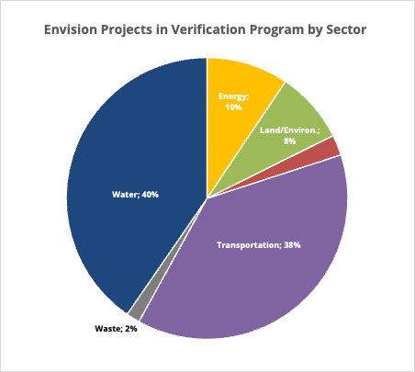
Envision projects in the verification program, by sector
All projects (registered, under review, & complete)
Geographic scale: United States
Total = 255
As of March 31, 2023

Slide 18
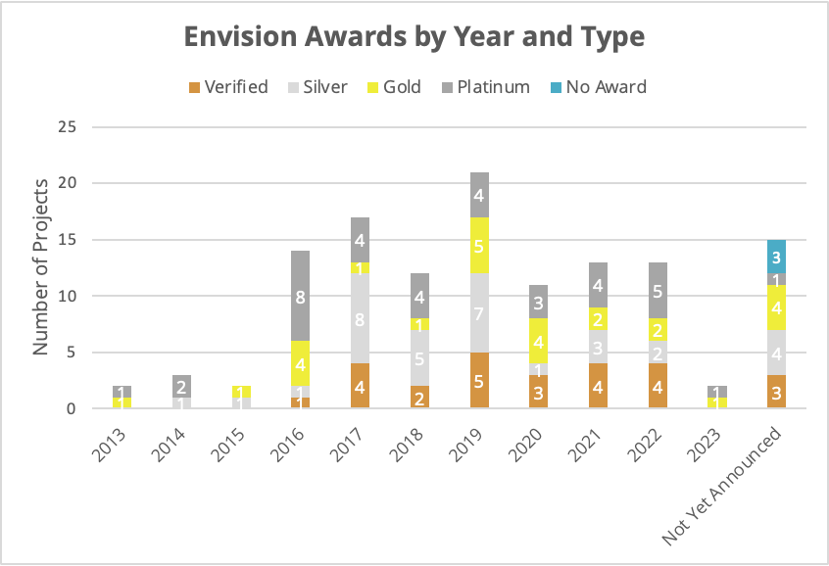
Envision awards, by year and type
Geographic scale: United States
To Date
Total = 125
As of March 31, 2023

Slide 19
Envision project registrations by year
Geographic scale: United States
Total = 255
As of March 31, 2023

Slide 20
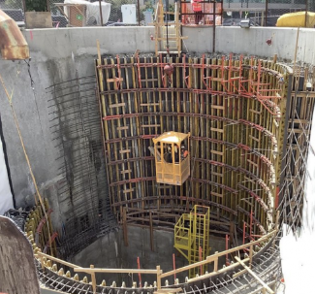
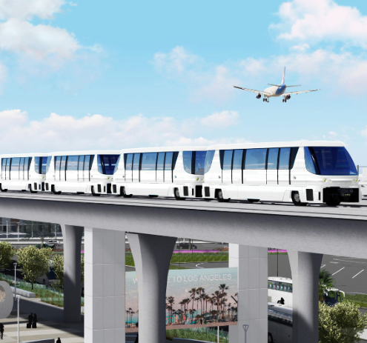
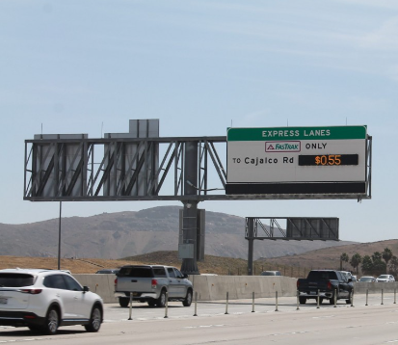
Recent Envision-verified projects
Ship Canal Water Quality Project
Seattle, WA Envision Platinum, 2022
LAX Automated People Mover Los Angeles, CA Envision Gold, 2022
I 15 Express Lanes Project Norco, CA Envision Verified, 2022
See the Envision Project Awards Directory for the complete list

Slide 21
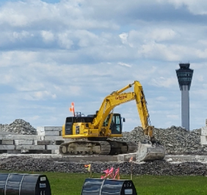
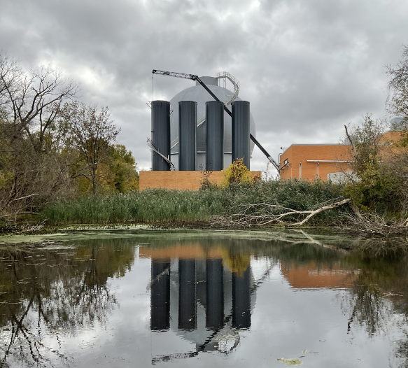
Recent Envision-verified projects
Indianapolis International Airport – Runway 5R Indianapolis, IN Envision Platinum, 2023
Holland Area WRF Anaerobic Digestion Holland, MI Envision Gold, 2023
See the Envision Project Awards Directory for the complete list

Slide 22
2
Envision by the numbers: education and credentialing

Slide 23
New ENV SPs

Slide 24
ENV SP Retention
Annual retention with cumulative growth
Notes:
2022 represents the third year with more new ENV SPs joining the network than those that have expired. The yellow bar indicates Inactive ENV SPs are counted here. Inactive RNV SPs have the opportunity to renew, and this number will ultimately decrease.

Slide 25
ENV SPs by Employer Type
Includes all Active and Inactive ENV SPs

Slide 26
ENV SPs by Country
Includes all Active and Inactive ENV SPs
International represents 46 countries

Slide 27
ENV SPs by State or Province
Top 20 locations; includes Active and Inactive ENV SPs

Slide 28
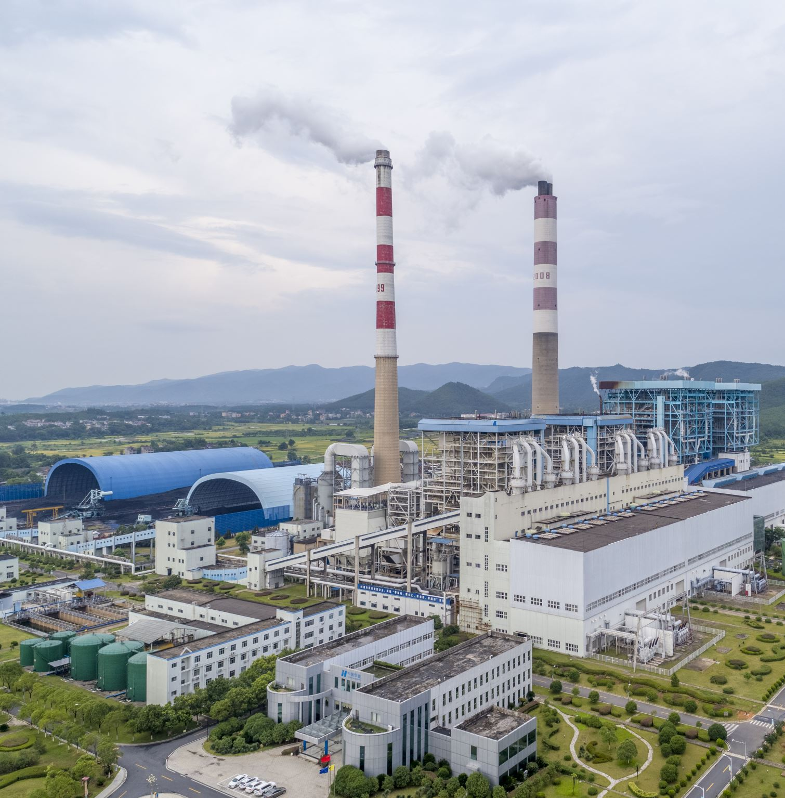
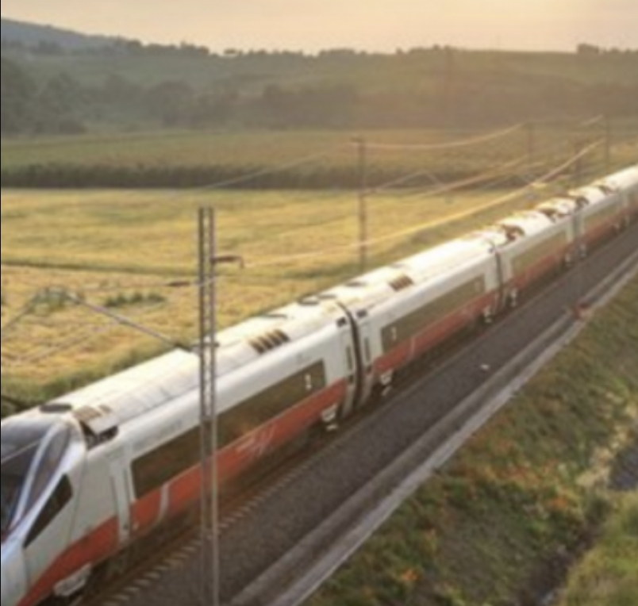
Recent Webinars and Live Events
The REAL Cost of Envision Moderated by: Michael Bloom
Amanda Marshall
Dennis Stanford
Clayton Sereres
December 14, 2022
Naples-Bari Italian High-Speed Railway Giuseppe Carcasi
Nicoletta Antonias
Silvia Ciraci
Giovanni Ranza
March 1, 2023
Blueprint for Envision with the NM Dept. of Transportation Jerry Paz
Molzen Corbin
April 5, 2023
Access the recording from the ISI All Courses library

Slide 29
New Envision Courses
Initiating Envision Use for Organizational and Project Readiness This course consists of two modules that tackle how Envision can positively transform organizational and project practices.
This course qualifies as prescribed content toward ENV SP Credential maintenance.
Access these and more from the ISI All Courses Library

Slide 30
3
Envision by the numbers: members and suppliers

Slide 31
Member Totals
ISI Member Totals: Corporate, Government, and Academic.
Corporate* | Government | Academic
258* 234 94
*This total also includes approx. 15 associations
Recent growth new member organizations
01/01/2021–06/30/2021: 40 07/01/2021–12/31/2021: 41
01/01/2022–06/30/2022: 65 07/01/2022–12/31/2022: 57 First Quarter 2023: 32

Slide 32
Most recent additions to ISI’s membership —public agency members
The following are the most recent public agencies that became ISI members in the past few months.
Ames Construction
BIM Arabia Academy
Bowling Green State University
California Polytechnic State University
Ontario Clean Water Agency
Public Services and Procurement Canada
Terrascale
The ELM Group University of New Mexico
US Air Force
City of Buena Park
City of Lakeland Water Utilities
King Saud University
McMaster University
Texas A&M University

Slide 33
Most recent additions to ISI’s membership — company members
The following are the most recent private-sector organizations to have joined ISI in the past few months.
TKDA Town of Severance Uganda Martyrs University Applied Sciences Consulting Inc Ardurra Group Arlington County Canadian Precast Prestressed Concrete Institute (CPCI) City of Riviera Beach City of Sun Prairie City of Wildwood – FL Harris County Precinct 4 Infrastructure Canada King County Solid Waste Division MARTA Norda Stelo South Carolina Office of Resilience
University of Technology Nowshera

Slide 34
4
Founders and global partners

Slide 35
Our founders
The following associations were instrumental in ISI’s formation in 2010. To this day, they are integral supporters of Envision and work closely with ISI to advocate for Envision in North America
American Society of Civil Engineers (ASCE)
American Public Works Association (APWA)
American Council of Engineering Companies (ACEC)

Slide 36
Our global partners
Italy
Institute for Certification and Quality Branding for Products and Services for Construction (ICMQ)
Mexico
Federación Mexicana de Colegios de Ingenieros Civiles (FEMCIC)
Canada
Canadian Society for Civil Engineering (CSCE)
Spain
Tecniberia and the Colegio de Ingenieros de Caminos, Canales y Puertos (CICCP)
East Africa
Miundo Misingi Hub

Slide 37
5
List of marketing resources

Slide 38
Brochures, toolkits and more
Envision
Brochure
Information Packet
Institute for Sustainable Infrastructure
Brochure
Envision Verification
Brochure Information Packet
Education and Credentialing
The ENV SP Credential: Benefits for students
ENV SP Information Packet
Membership
Brochure
Information Packet
Envision Canada
Brochure
Advocacy
Advocacy Toolkit

Slide 39
Contact information Email: info@sustainableinfrastructure.org Phone: (202) 991-1190

