Slide 1
Sustainability and the Role of Envision
2019

Slide 2


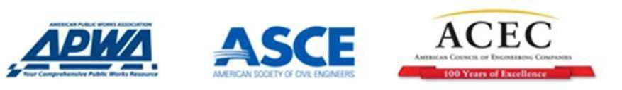
Envision is a Joint Collaboration
ISI Founding Organizations
Section 1: Introduction to ISI and Envision
Notes:
Script:
Envision was developed in joint collaboration between the Institute for Sustainable Infrastructure and the Zofnass Program for Sustainable Infrastructure at the Harvard University Graduate School of Design.
The Institute for Sustainable Infrastructure is a not-for-profit education and research organization founded by the American Public Works Association, the American Council of Engineering Companies and the American Society of Civil Engineers.
Each founding organization was developing a sustainable infrastructure program and saw the need for a standardized framework for classification of sustainability practices. The organizations decided to work together to form ISI to develop and manage Envision. Along the way, there was collaboration with federal agencies, universities, consultants, professional societies, municipalities, and others. This tool was vetted by industry experts.

Slide 3

Section 1: Introduction to ISI and Envision
Notes:
Script:
The purpose of Envision is “to foster a dramatic and necessary improvement in the performance and resiliency of our physical infrastructure across the full spectrum of sustainability.” Envision provides the framework and incentives needed to initiate this systemic change. As a guidance tool, Envision provides industry-wide sustainability metrics for all infrastructure types.
While initially developed for the US and Canada, Envision is being applied world-wide.
Note:
Envision timeline is:
First version of Envision for industry review and comment came out July 5, 2011
ISI and the Zofnass Program merged their two systems in the fall of 2011
Second version of Envision came out February 16, 2012 for self-assessments
The Envision Sustainability Professional credential became available in April 2012
Project verification began in September 2012
The first project was verified for award in 2013
Envision v3 was launched April 2018

Slide 4
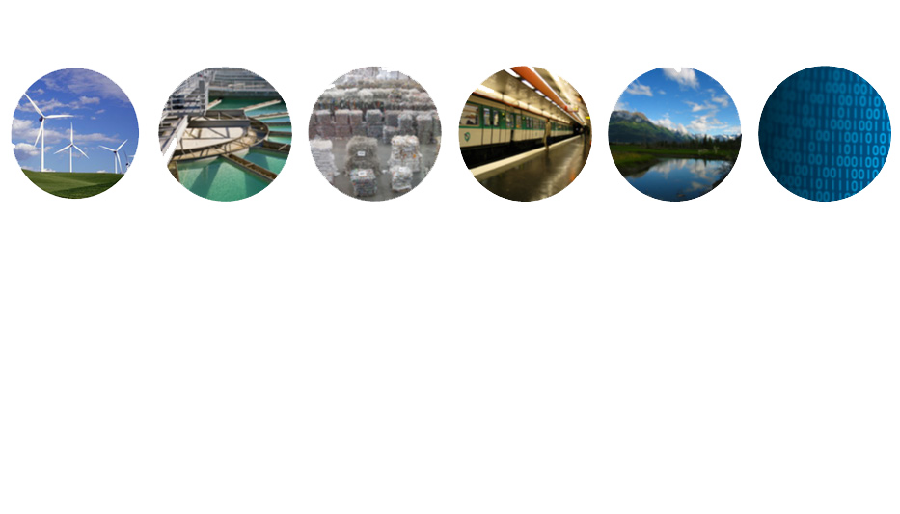
Types of Infrastructure Envision Rates
ENERGY
Geothermal
Hydroelectric
Nuclear
Coal
Natural Gas
Oil/Refinery
Wind
Solar
Biomass
WATER
Potable water distribution
Capture/ storage
Water Reuse
Storm Water Management
Flood Control
WASTE
Solid waste
Recycling
Hazardous
Waste
Collection &
Transfer
TRANSPORT
Airports
Roads
Highways
Bikes
Pedestrians
Railways
Public Transit
Ports
Waterways
LANDSCAPE
Public Realm
Parks
Ecosystem
Services
Natural
Infrastructure
INFORMATION
Telecommunications
Internet
Phones
Data Centers
Sensors
Section 1: Introduction to ISI and Envision
Notes:
Script:
Envision was designed as a holistic framework to apply to ALL types and sizes of civil infrastructure. This includes the roads, bridges, pipelines, railways, airports, dams, levees, landfills, water treatment systems, and other components that make up our civil works.
Envision is not designed to evaluate buildings intended exclusively for human occupation such as hospitals, schools, offices, or residences.
(First Point):
Most available sustainability rating systems for infrastructure are sector specific or regionally based. For example, there are rating systems specific to buildings, roads, airports, etc. And there are rating systems in use by a city or state. There was no comprehensive U.S. system that covers all aspects of infrastructure.
Envision was designed to fill this need. Over 900 sustainability guidance and rating systems were evaluated to identify gaps, develop goals, and refine an approach.
Envision is not intended to supplant existing, sector-specific infrastructure rating systems. It is intended to provide the essential context for their rating results.
(Second Point):
The rating system for buildings are gaining popularity, but these aren’t applicable or transferrable for infrastructure projects. Much of the focus of these systems is on the comfort and health of the building occupants, but most infrastructure does not have occupants.
Infrastructure has different challenges than buildings . Buildings are under the control of a single owner or entity. You can readily optimize building systems.
For infrastructure, there is no single responsible entity. There are multiple departments with different issues, agendas, schedules, budgets, customers and integration needed at the city/community and regional levels.

Slide 5





64 Credits in 5 Categories
Quality of Life
14 Credits
Wellbeing, Mobility, Community
Leadership
12 Credits
Collaboration, Planning, Economy
Resource Allocation
14 Credits
Materials, Energy, Water
Natural World
14 Credits
Siting, Conservation, Ecology
Climate & Resilience
10 Credits
Emissions, Resilience
Section 1: Introduction to ISI and Envision
Notes:
Script:
The Envision sustainable infrastructure rating system is a comprehensive framework of 60 criteria that encompass the full range of environmental, social, and economic impacts that should be assessed in order to determine how a project has incorporated sustainability in its design, construction, and operation. These 60 sustainability criteria, called ‘credits’, are arranged in five categories.
Quality of Life specifically addresses a projects impact on communities from the health and wellbeing of individuals to the wellbeing of the larger social fabric as a whole.
Leadership is comprised of the tasks that demonstrate effective leadership and commitment by all parties involved in a project. The meaningful commitment from the owner, team leaders, & constructors.
Resource Allocation measures the use of renewable and non-renewable resources for the project. Benefits of managing resources needed will allow a longer life as we know it.
Natural World allows project teams to assesses the effect of the project on the preservation and renewal of ecosystem functions. This section addresses how to understand and minimize negative impacts while considering ways in which the infrastructure can interact with natural systems in a synergistic and positive way.
Climate And Risk looks at two main concepts: minimizing emissions that may contribute to increased short- and long-term risks and ensuring that infrastructure projects are resilient to short-term hazards or altered long-term future conditions.

Slide 6
The Envision Framework
Envision Guidance Manual
Envision Pre-Assessment Checklist
Envision Online Scoresheet
Envision Sustainability Professional Credential
Envision Verification
Envision Awards
Section 1: Introduction to ISI and Envision
Notes:
The Envision components are
Envision Guidance Manual
Envision Pre-Assessment Checklist
Envision Online Scoresheet
Envision Sustainability Professional Credential
Envision Verification
Envision Awards

Slide 7
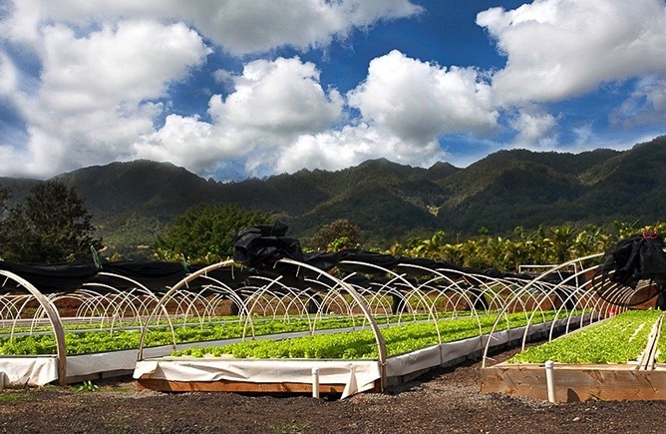
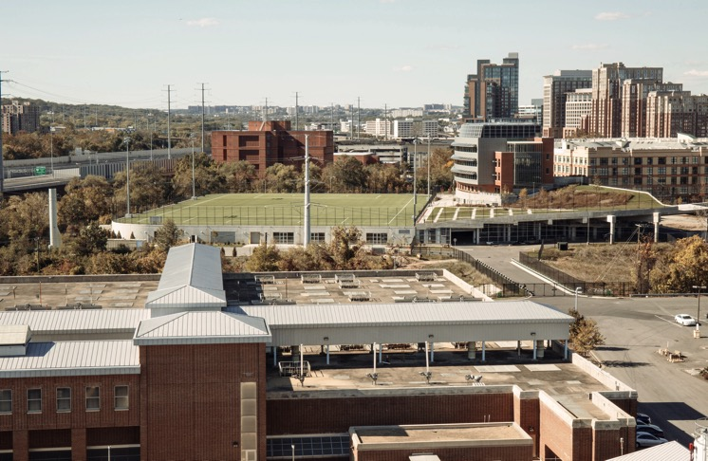
Kunia County Farms
Aquaponics Farm
Hawaii, USA
Envision Gold, 2016
Nutrient Management Facility
Treatment plant
Virginia, USA
Envision Platinum, 2016
Section 1: Introduction to ISI and Envision
Notes:
The next 2 slides are meant to show quick highlights of Envision project award examples
The Envision framework has been used on hundreds of projects and tens of billions of dollars in infrastructure projects have pursued third-party verification and awards throughout the US, Canada, and internationally. The full range of the six components we just reviewed has been applied in a variety of ways across every sector of infrastructure. To name a few examples:
The Nutrient Management Facility in Alexandria, Virginia earned Envision Platinum in 2016
The Green Build Project at San Diego International Airport in California earned Envision Platinum in 2016
The Kunia County Farms in Hawaii earned Envision Gold in 2016
The I-4 Ultimate Improvement in Florida earned Platinum in 2017
The Surrey Biofuel Facility in British Columbia earned Envision Platinum in 2017
Throughout this course we will explore these and other examples to identify the best practices for implementing the 6 components of the Envision framework across all sectors of infrastructure. Let’s begin to discuss how Envision is applied to projects like these by brainstorming different uses for the framework (segue to next set of slides/brainstorm: “How can you use Envision?”)
7

Slide 8
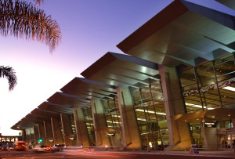
Green Build Project
San Diego International Airport
California, USA
Envision Platinum, 2016
Section 1: Introduction to ISI and Envision
Notes:
The Envision framework has been used on hundreds of projects and tens of billions of dollars in infrastructure projects have pursued third-party verification and awards throughout the US, Canada, and internationally. The full range of the six components we just reviewed has been applied in a variety of ways across every sector of infrastructure. To name a few examples:
The Nutrient Management Facility in Alexandria, Virginia earned Envision Platinum in 2016
The Green Build Project at San Diego International Airport in California earned Envision Platinum in 2016
The Kunia County Farms in Hawaii earned Envision Gold in 2016
The I-4 Ultimate Improvement in Florida earned Platinum in 2017
The Surrey Biofuel Facility in British Columbia earned Envision Platinum in 2017
Throughout this course we will explore these and other examples to identify the best practices for implementing the 6 components of the Envision framework across all sectors of infrastructure. Let’s begin to discuss how Envision is applied to projects like these by brainstorming different uses for the framework (segue to next set of slides/brainstorm: “How can you use Envision?”)

Slide 9
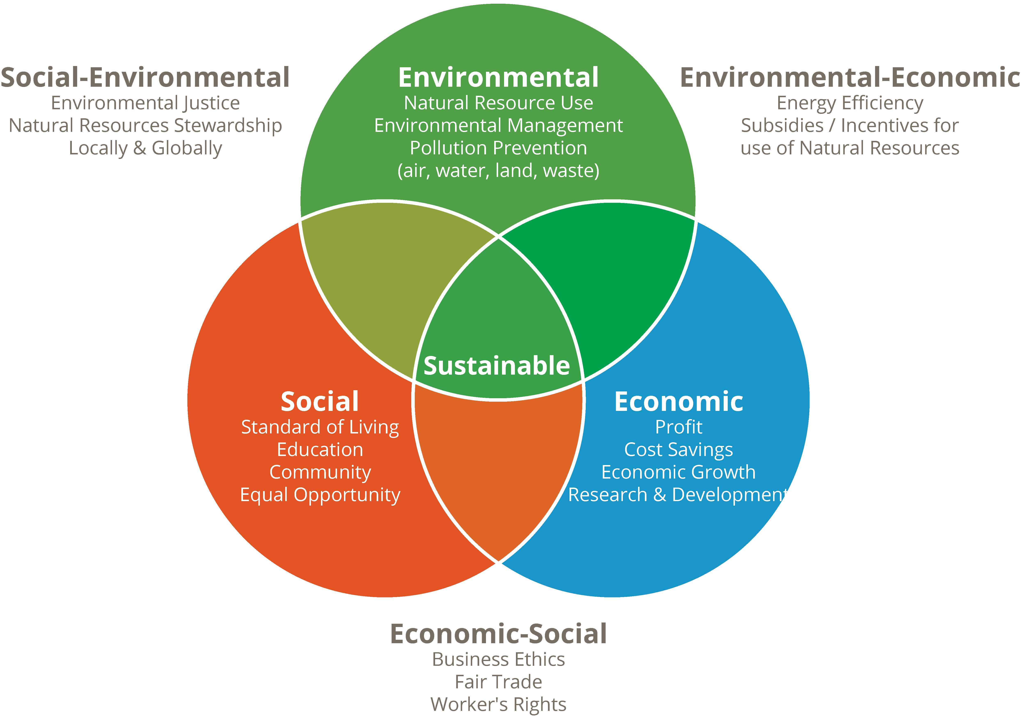
Sustainability
Section 2: Sustainability and the Role of Envision
Notes:
Script:
Sustainability is found in the triple bottom line: Environmental protection and resource conservation, social well-being and equity, and economic prosperity and continuity. This is sometimes called “People, Planet, Profit”. This is traditionally represented in a Venn diagram, as shown on the left.
For a project, or program, even a city or nation, to be sustainable, it’s essential that these critical elements be in balance. This balance defines how a project, or community, can continue functioning over the long term. The way we traditionally worked on infrastructure, a large part of this balance was missing. Today, project planners and owners are becoming more aware of the things that truly define successful infrastructure.
As we see and document unprecedented changes, including rising seas, fiercer storms, income and opportunity inequality, and resource constraints, to name a few, municipalities and other civil entities are seeking better, more sustainable solutions to infrastructure challenges over the long haul. They are leveraging new promising research on products, methods, procedures and the like that fulfill infrastructure needs, but are lighter in impact and conceived in a transparent, inclusive decision process. Clearly, this is a topic that transcends our traditional engineering approaches, and really considers the “big picture”. Doing true sustainable infrastructure considers what we previously called externalities, things like quality of life, social costs and benefits, unintended consequences, economic development, and more.

Slide 10
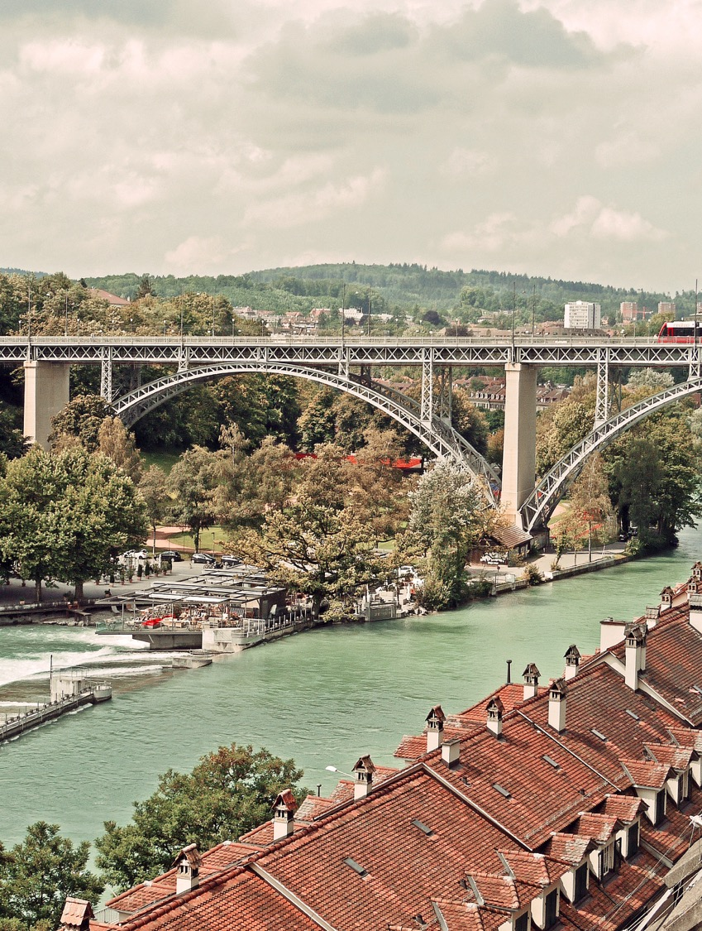
Challenges
Development vs. impact
Changing operating environments
Notes:
Sustainable development is not achieved without facing a few inherent challenges. We must consider not only the finite resources available to us, but also do so recognizing that the environment is rapidly changing.
Let’s consider these challenges further.

Slide 11
“Sustainable development is…
…development that meets the needs of the present without compromising the ability of future generations to meet their own needs.”
-Brundtland Commission Report 1987
United Nations. 1987."Report of the World Commission on Environment and Development." General Assembly Resolution 42/187, 11 December 1987
http://www.un.org/documents/ga/res/42/ares42-187.htm
Notes:
Now that we’re all on the same page with how we define sustainability, in order to talk about the challenges we’re facing, we must also address progress and what does sustainable development look like?
As you may know, sustainable development was first articulated as a global principle by the Brundtland Commission (formally the World Commission on Environment and Development, 1983-1987). Chaired by Dr. Gro Harlem Brundtland, a medical doctor and Norway’s first woman Prime Minister, the commission’s final report included the definition shown here. The report stated that sustainable development is development that meets the needs of the present without compromising the ability of future generations to meet their own needs. There have been many eloquent, complex and simplified definitions since then, but the Brundtland Commission capture it well. In short, we need to complete our time on earth, leaving enough resources of sufficient quality remaining for the next generation to do the same.

Slide 12
Development vs. Resources
3
Approx. definition of “good” quality of life
2
Ecological Footprint
Resources available on Earth
Sustainability Quadrant
1
0
0.5
0.6
0.7
0.8
0.9
1.0
Source: Living Planet Report (2006), World Wildlife Fund
Developing
Developed
Human Development Index
Section 2: Sustainability and the Role of Envision
Notes:
We further define sustainable development by addressing the first big challenge, where we recognize that we all want to improve our quality of life, but we generally need resources in order to do so. The challenge comes into play when we consider that everyone on earth has the same goal of improving their quality of life, yet there are only a finite amount of resources available for everyone to achieve this goal.
To better understand this challenge, we should better understand the existing relationship between improving quality of life and use of resources.
The World Wildlife Fund recommends that we compare the human development index, which means the quality of life, to the ecological footprint, or the consumption of resources.
In exploring this relationship, we should also define the desired values:
Developed countries have a human development index from 0.8 to 1.0. We’ll use this to define a “good” quality of life.
The available resources on earth per person was calculated as 1.8 global hectares / person
This allows us to define the “sustainability quadrant”. This is the region on the graph where countries have a good quality of life with minimal resource consumption. Ideally, this is where all countries will fall; this is our ultimate end goal.
So, how do we think we’re doing so far? Where is the US? Where is Canada?

Slide 13
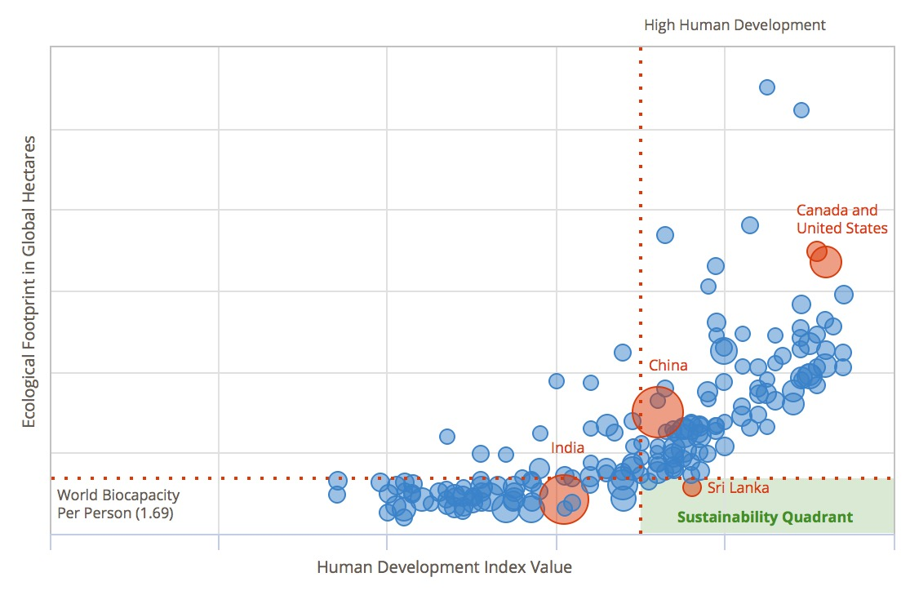
Development vs. Resources
Section 2: Sustainability and the Role of Envision
Notes:
script:
When we add data, we can begin to see the relationship between quality of life and resource use. Generally, countries are either living below the “fully developed” level and not using many resources OR living with a high quality of life, but using more resources than are available to achieve that quality of life.
The challenge is how make a meaningful shift towards the sustainability quadrant, without sacrificing quality of life and how do we in the infrastructure industry begin to address this?

Slide 14
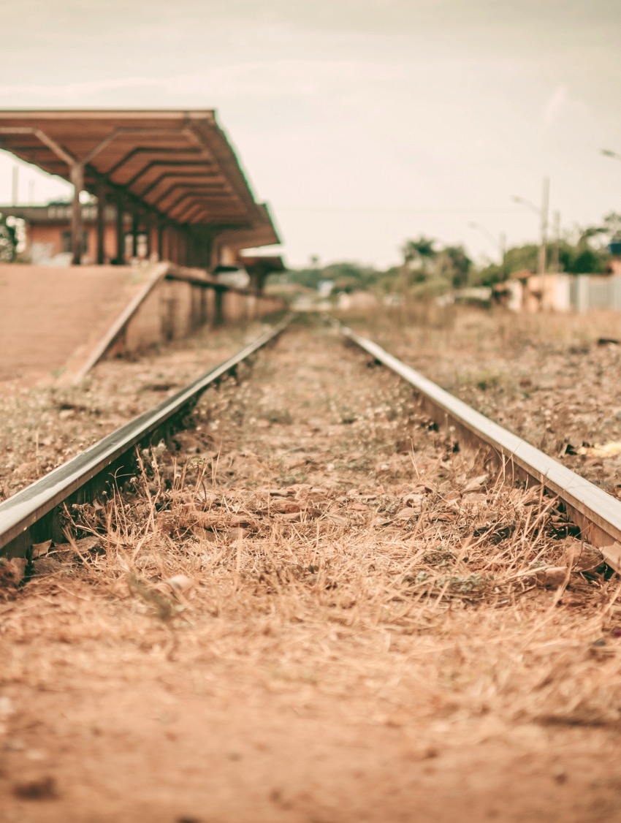
Changing Environment
What is the new “normal”?
What are the possible extremes?
Are there any new variables?
Notes:
Further aggravating this challenge are the unknowns we face in the coming months, years, decades and centuries.
Operating conditions will change, requiring determinations of new averages, variances and possible extremes. New variables and new relationships among existing variables will appear and need to be taken into account.
For example, what we have as a widely available resource today may not be the case 10 or 100 years from now. Resource demands will drive up the cost and scarcity of important materials and fuels.
Extreme weather events and atypical weather patterns may change the operating environment.

Slide 15
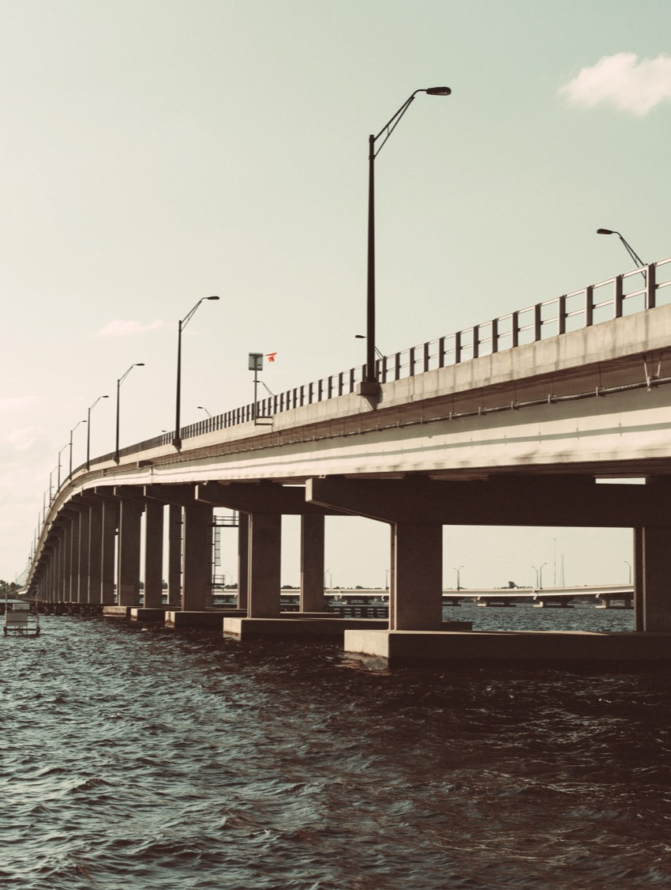
Infrastructure’s Role
How does infrastructure help us support sustainable development in the face of these inherent challenges?
Notes:
Now we must ask, what’s infrastructure’s role in all of this? How does infrastructure help us support sustainable development in the face of these inherent challenges?
Efficient infrastructure is an essential component for a prosperous and growing economy. Effective transportation systems bring goods to market, workers to jobs, children to schools, and families to stores and recreation areas in a safe and timely manner. Dependable water and wastewater systems bring fresh water to industry, agriculture, and people. Reliable electricity supplies allow businesses and factories to work unimpeded and bring a high level of convenience and productivity to home life across the nation. Extensive telecommunication networks connect people and businesses across the globe and enable the fast flow of information essential to commerce.
Infrastructure should deliver the required services at affordable costs while conserving natural resources and energy. Moreover, these services must be continually maintained and improved in order to remain competitive in the global marketplace. Today, however, the design, construction and operation of our infrastructure systems have a substantial negative impact on our natural resources and ecological systems. If allowed to continue, this overuse of natural resources will have devastating consequences.

Slide 16

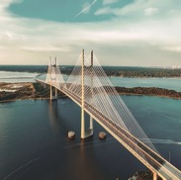

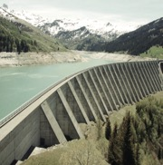
Infrastructure’s Role: Long-term
Highways
20-50 years
Bridges
30-75 years
Pipelines
50-100 years
Dams
50-100 years
Notes:
Script:
In considering the changing operating environment, we also recognize that infrastructure is long lived. The highways, bridges, power stations and wastewater treatment plants we build today have design lives ranging from 20 to over 75 years. This means that the infrastructure we are building today will establish the energy, water and materials efficiencies, and ecosystem impacts for decades to come. Therefore, whatever we build today, we better get it right. We must do the best we can with existing technologies, designing and delivering the most resource and energy conserving infrastructure within the limits of budgets and priorities. In addition, the efficiency and effectiveness of infrastructure depends not only on its intrinsic design, but on how that design integrates and functions for the community in which it resides.

Slide 17
Strategies For Changing the Industry
Make incremental improvements
Use standardized tools and metrics
Document sustainable practices
Monitor Performance
Share lessons learned
Global view, keeping in mind local values
Section 2: Sustainability and the Role of Envision
Notes:
So, how does infrastructure do it all? How do we shift our mindset such that we’re building infrastructure that helps communities develop sustainably and for the long-term?
It’s not necessary for every project to hit a “sustainability home run” to move things forward. In each project, there’s something you can change to create a better result. How big or global this can be really hinges on project’s owners, local community values, appetite for innovation, health of the local economy, and frankly, your ability to energize stakeholders on the benefits of taking new approaches.
Standardized tools like Envision can help you make the case because of its emphasis on transparency, inclusivity and bringing externalities into the discussion early on. When we use proprietary approaches and tools, it can be difficult to compare alternatives across boundaries and between owners, reducing your ability to leverage lessons not learned in the community in question. Standardization means we can compare the benefits of a port in Seattle with a wastewater treatment plant in Boise.
For each project in which you’re able to try something new, document your work extensively and monitor performance after the fact! This is a new landscape, and we can’t afford to lose any data sets. Each time, set clear goals, objectives, and KPIs and define how you’ll measure against these metrics. What we measure, we can manage, and that’s what leads to improvements.
As you learn from your work, report results out to your peers, to professional societies, and to the public at large. Use ISI as a clearinghouse for your work. Transparency is key here. Talk openly and honestly about your work and help others move the ball forward by sharing what you learn. Only by doing this will our new methods become mainstream and form the new “business-as-usual”.

Slide 18
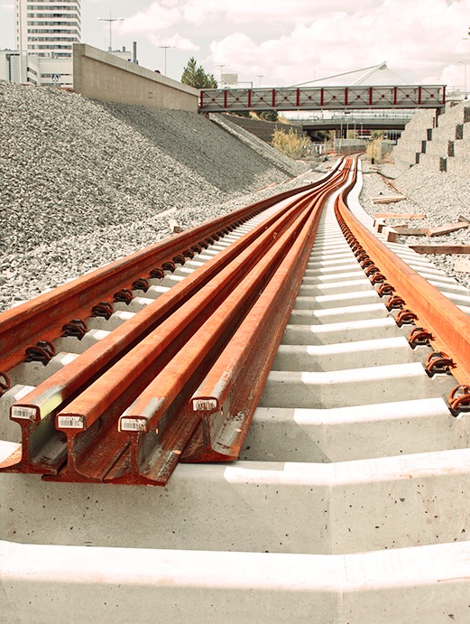
Envision’s Approach
Harness proven strategies to face sustainability challenges head-on
Notes:
Envision helps us harness these strategies to design sustainable infrastructure that faces development challenges head-on. In the next few slides we’ll explore Envision’s approach to addressing these challenges.

Slide 19
Mitigation Hierarchy
Avoidance
Minimization
Abatement
Offsetting
Section 2: Sustainability and the Role of Envision
Notes:
In taking practical steps toward sustainability, it can be difficult to discern how to prioritize options or even take the first step. One way to prioritize these options is to consider the mitigation hierarchy.
Avoidance: Measures taken to avoid creating impacts from the outset
Minimization: Measures taken to reduce the duration, intensity or extent of impacts that cannot be avoided
Abatement: Measures taken to rehabilitate degraded ecosystems
Offsetting: Measures taken to compensate for any residual adverse impacts
The Envision framework applies this hierarchy across a range of topics. For example, when considering social impacts of a project it is just as important to first avoid adverse impacts as it is when considering environmental implications.

Slide 20
Expanding Opportunities for Performance Improvement
Project Phases
  More durability and flexibility
  End of life disassembly, up-cycling
Stakeholder Collaboration
  Project team collaboration
  Stakeholder issues and concerns
Performance Achievement
  Beyond sustainable equilibrium
  Restoration of systems
Section 2: Sustainability and the Role of Envision
Notes:
Script:
Envision provides opportunities to improve projects in three dimensions
First is the project life cycle. We are trying to go beyond planning and design to the construction phase to consider operations and maintenance and also the end of useful life, such as the ability to disassemble and up-cycle materials.
Second is stakeholder collaboration. When an inclusive, representative group of stakeholders is engaged throughout planning and design, resultant projects satisfy the widest possible swath of the community. Planning/design team collaborations with stakeholders also identify the widest practical array of sustainability alternatives for consideration, including by-products synergies and social benefits.
Third are the levels of sustainability achievement. Envision offers credit for a wide range of sustainability success, from slight to outstanding.

Slide 21
Making the Most of Opportunities
Section 2: Sustainability and the Role of Envision
Notes:
As a project progresses over time the ability to influence its overall sustainability decreases while the cost to do so increases. Broad and effective collaboration early in a project can increase the sustainability potential at little to no cost. The perception of sustainability as a ‘premium’ results from trying to apply sustainability late in development to a business-as-usual project.

Slide 22

    Recognizing Innovation
    Extraordinary performance
    Overcoming significant barriers
    Scalable
    Transferable
Section 2: Sustainability and the Role of Envision
Notes:
Script:
Innovation drives forward the state-of-the-art in sustainable infrastructure. There are points for innovation related to:
going above and beyond the highest achievement level for a specific credit
Overcoming barriers
Creating solutions that are scalable
Creating solutions that are transferable

Slide 23
Advancing Sustainability Knowledge and Education
Captures, retains, and disseminates knowledge
Creates a new breed of sustainability engineer/practitioner
Section 2: Sustainability and the Role of Envision
Notes:
Script:
Traditional engineering is only the beginning. Envision encourages, even requires us to gain new knowledge and broaden perspective. To truly do sustainable infrastructure, we need to understand the interconnected nature of what we do, how each project connects to the community within which it functions. This is a richer landscape that requires much more inclusive participation and wider horizons. The New Breed of Practitioner we’re trying to create understands the wider implications of this work, and brings the judgement and skill to plan, build, and operate in this new paradigm.
Captures, retains, and disseminates knowledge
Designed to guide sustainable project conception and delivery
More than specifications, e.g., “% waste sent to landfill”
Creates a new breed of sustainability engineer/practitioner
Good knowledge of what it takes to develop projects that truly contribute to sustainability
Ability to work within the new sustainability paradigm

Slide 24
Questions?
Notes:
Notes to Trainer:
Poll the participants (yes/no answers will suffice here; if ‘no’, make sure to identify the pain points and clarify before moving forward)
Can you demonstrate how infrastructure can address the challenges inherent to sustainable development?
Did you discover infrastructure’s role in overcoming challenges in achieving sustainability?
Did you demonstrate how the Envision framework relates to sustainable infrastructure?

